Slide 1
Credit Card Fraud Detection system
Done by: Aashka vijapura

Slide 2
Agenda
Objective
Background
Key Insights
Cost Benefit Analysis
Appendix:
o Data Attributes
o Data Methodology

Slide 3
Objective
Putting in place a system to detect credit card theft in order to reduce expenses
A manual detection method for frauds result in significant costs

Slide 4
Background
A machine learning algorithm was created to identify frauds quickly and reduce losses.
For its deployment, a cost-benefit analysis has been conducted.

Slide 5
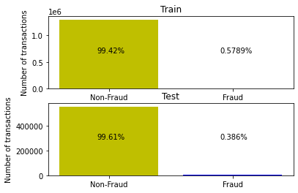
Key Insights
Transaction amount, category and gender are the most important variables
Gas and transport, kids and pets, home are the top three categories
Highly imbalanced dataset
 | Varname | Imp
0 | amt | 0.876727
13 | category_kids_pets | 0.029171
8 | category_gas_transport | 0.023109
12 | category_home | 0.013885
19 | category_travel | 0.010977
18 | category_shopping_pos | 0.010669
10 | category_grocery_pos | 0.009082
15 | category_misc_pos | 0.008953
7 | category_food_dining | 0.005615
17 | category_shopping_net | 0.003883
1 | gender | 0.002981
3 | age_at_trans | 0.002070
2 | city_pop | 0.002070
11 | category_health_fitness | 0.000412
9 | category_grocery_net | 0.000194
14 | category_misc_net | 0.000098
4 | lat_dist | 0.000092
6 | trans_month | 0.000013
5 | long_dist | 0.000000
16 | category_personal_care | 0.000000

Slide 6
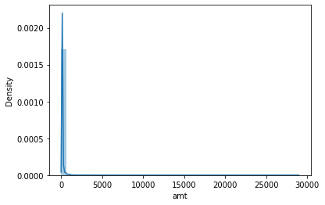
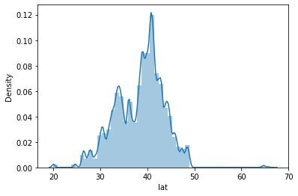
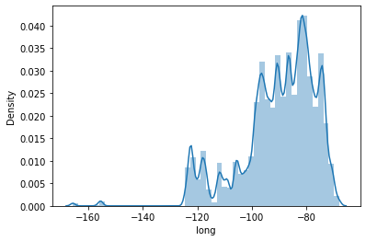
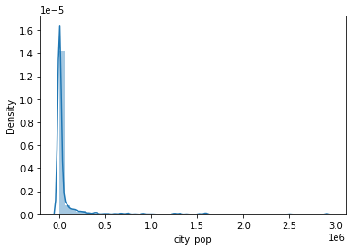
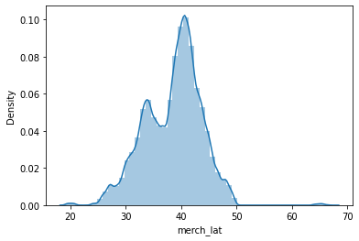
Key Insights

Slide 7
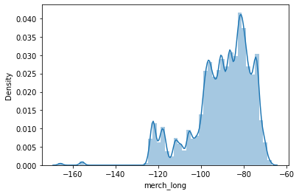
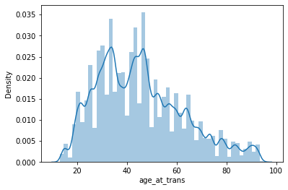
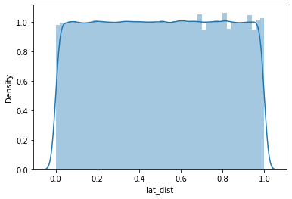

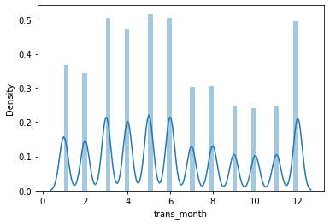
Key Insights

Slide 8
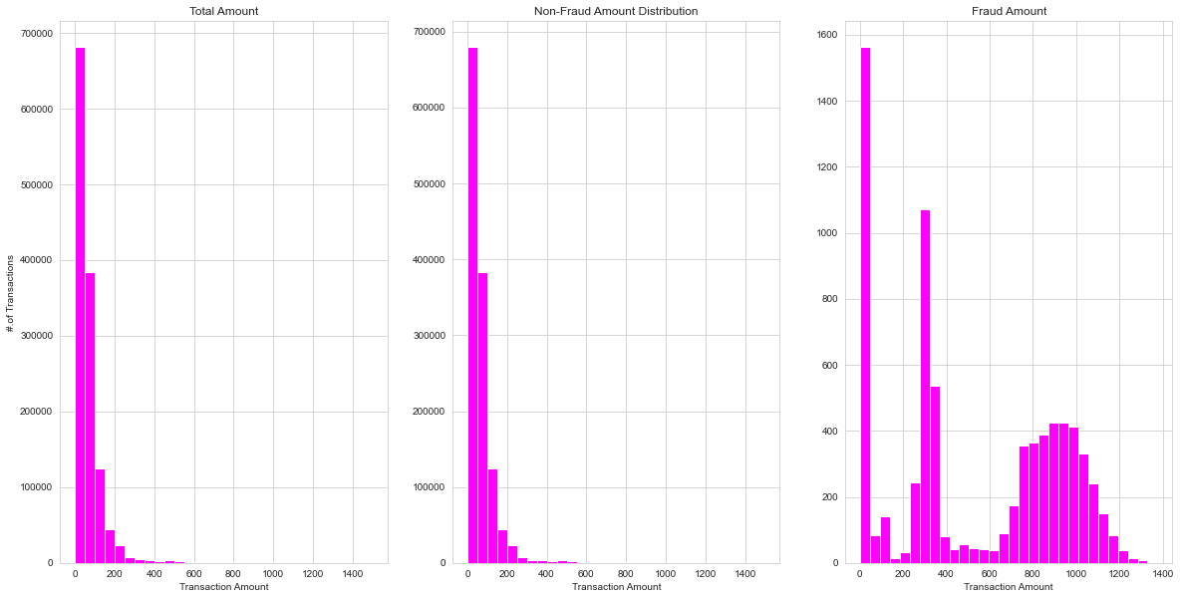
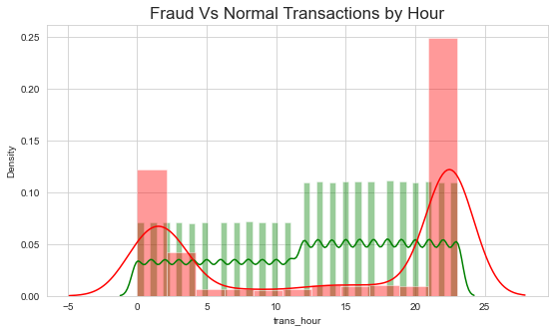
Key Insights

Slide 9
Current Incurred Losses
77,183 credit card transactions per month
402 fraudulent transactions per month
$ 530.66 amount per fraud transaction
Total costs incurred from fraud transactions is $ 213,392.22

Slide 10
After New Model Deployment
1720 fraudulent transactions detected by the model
$ 1.5 cost to provide customer support to these transactions that is $ 2,580.38 in total
27 fraudulent transactions not detected by model which amounts to $ 14,283.64 loss
Total cost incurred after new model deployment is $ 27410.51
Final savings after new model deployment is $185981.71 that is reduction in losses by ~ 87%

Slide 11
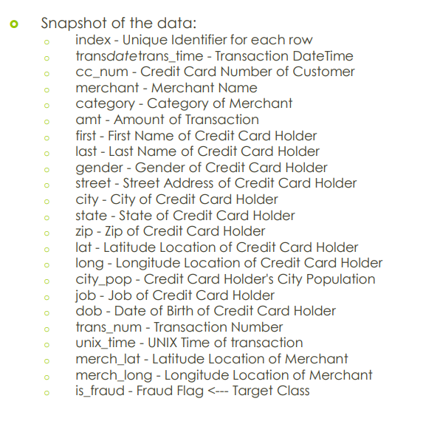
Appendix: Data Attributes
Snapshot of the data:

Slide 12
Appendix: Data Methodology
A random forest classifier built on top a Kaggle simulated dataset
Class imbalance adjusted using Adaptive Synthetic (ADASYN) sampling method
Manual hyperparameter tuning done due to extensive computational times when using Grid Search Cross Validation

Slide 13
THANK YOU

